Slide 1

- By Sibani Panda
EXPLORATORY DATA ANALYSIS
Understanding Loan Default Patterns : A Risk Analytics Approach

Slide 2
CONTENT
Problem Statement & Business Justification
Data Cleaning
Data Imbalance Ratio
Analysis based on the Gender of the client
Analysis based on the Income Type of the client
Analysis based on the Education Level of the client
Correlation Matrix between Education Level, Income Level and Defaulter Rate
Correlation Matrix between Education Level, Loan Credit Amount, and Defaulter Rate
Segmented Univariate and Bivariate Analysis of Education Level
Analysis based on the Family Status of the client
Analysis based on the Housing Type of the client
Analysis based on the Occupation Type of the client
Income Distribution across various Occupation Type
Analysis based on the Age of the client
Analysis based on the count of the Children & Family member of the client
Analysis based on the Income Level of the client
Analysis based on the Contract Type of the Loan
Analysis based on the ownership of car
Analysis based on the ownership of house/flat
Analysis based on the Contract Status of the previous loan applications
Correlation Matrix between Age, Income Level and Defaulter Rate
Correlation Matrix - Goods, Application Amount, Amount Credited, & Annuity Amount
Conclusion

Slide 3
PROBLEM STATEMENT:
Applying Exploratory Data Analysis (EDA) techniques in a real business scenario to determine if the consumer lending company should lend loan to its Clients or not.
Understanding the risk analytics in banking and financial services, particularly in minimizing the risk of losing money while lending to customers.
Analyzing the patterns in the previous and current loan application data given to identify factors influencing loan repayment and default.
BUSINESS JUSTIFICATION AND OBJECTIVE:
Loan providers face challenges in assessing creditworthiness due to insufficient or non-existent credit history, leading to potential losses from defaults.
Assuming that I am working for a consumer finance company specializing in lending to urban customers, aiming to use EDA to analyze data patterns and ensure capable applicants aren't rejected.
Two main risks associated with loan decisions: loss of business if capable applicants are rejected, and financial loss if loans are approved to likely defaulters.
Data contains information on payment histories and application decisions, aiming to understand how consumer and loan attributes influence default tendencies.
Identifying the patterns indicating clients' difficulty in paying instalments to take appropriate actions such as denying loans, adjusting loan amounts, or offering higher interest rates to risky applicants.
Using EDA to identify applicants capable of repaying loans, reducing rejections, and understanding driving factors behind loan default for portfolio and risk assessment purposes.
Enhancing the understanding of risk analytics domain, including types of variables and their significance in loan default prediction.

Slide 4
DATA CLEANING: IMPUTATION/REMOVAL OF MISSING VALUES, HANDLING OUTLIERS, REMOVING INCONSITENCIES IN THE DATA
Removal of all the columns from the dataset having more than 40% null values.
As most of the clients have not provided their occupation details, we can impute those values with a separate category called ‘No Occupation Data’ as deleting those rows having null values (which is actually higher in number) might lead to data loss and may lose information in other column which might be important
The Gender info is having another value ‘XNA’ which has been replaced/imputed with the mode ‘F’ as the count of Female is much higher in number as compared to Male in the given dataset and wont impact the analysis if few more Female are added.
In Organization Type data, 18% of the value is ‘XNA’. These values cannot be imputed using any method as we cannot assume the organization type for the client, which would lead to wrong analysis. Hence, dropping all the ‘XNA’ values.
In the Organization type, few of the values are repeated and suffixed with ‘Type1,2,3..” which does not give any proper information, hence grouping them into single category.
Conversion of the Good Price, Loan Credit Amount, Income of the client, Annuity to integer type & binning them to convert into categorical variable for ease of analysis
Outliers in income or credit amount can skew analysis, hence binning can group extreme values into separate bins, preventing them from disproportionately influencing the results.
Age of the client is initially given in days, which is converted into age in years and binning them into groups for better analysis
Now, the data is clean and can be used for analysis

Slide 5
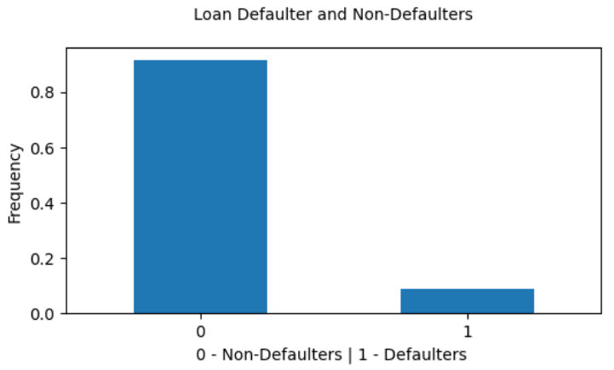
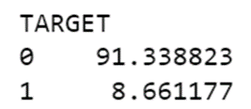
DATA IMBALANCE RATIO –NON-DEFAULTER vs DEFAULTER
The data shows a significant imbalance, with a ratio of 10.55 between non-defaulters and defaulters.
Almost 91% of the dataset consists of non-defaulters, while only 9% are defaulters.
This ratio is expected because a consumer lending company cannot sustain itself if there are more defaulters, potentially leading to losses.
In the graph, Target 0 represents non-defaulters, while Target 1 represents defaulters.

Slide 6
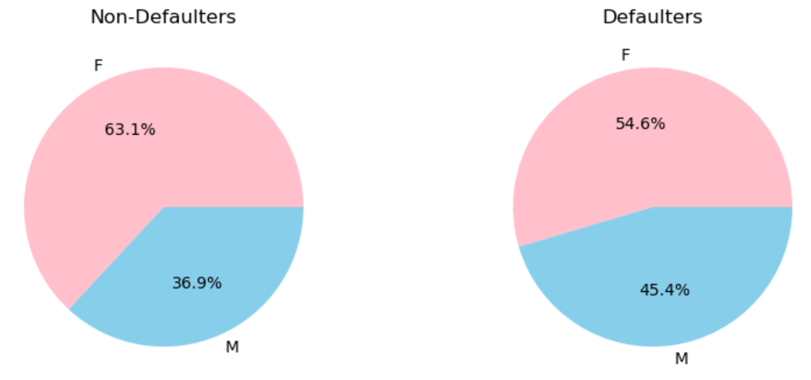
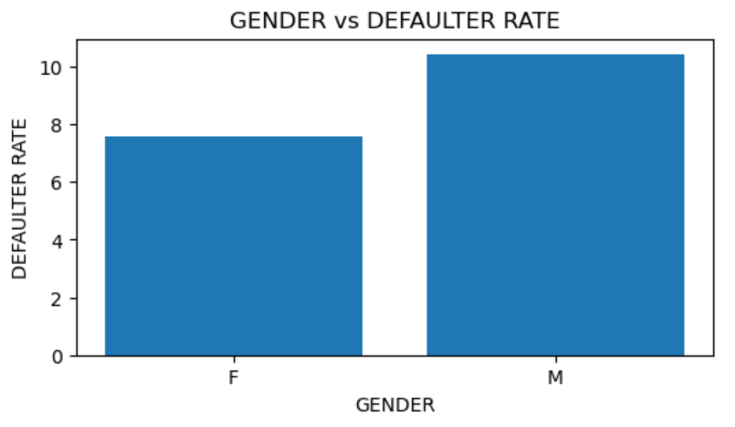
ANALYSIS BASED ON THE GENDER OF THE CLIENT
SEGMENTED UNIVARIATE ANALYSIS
BIVARIATE ANALYSIS
Though the loan application rate is higher for females both in case of non-defaulters and defaulters, the defaulters rate is higher for males.
This indicates that male has loan repayment difficulties and have either delayed the instalment or not paid at all in some cases.

Slide 7
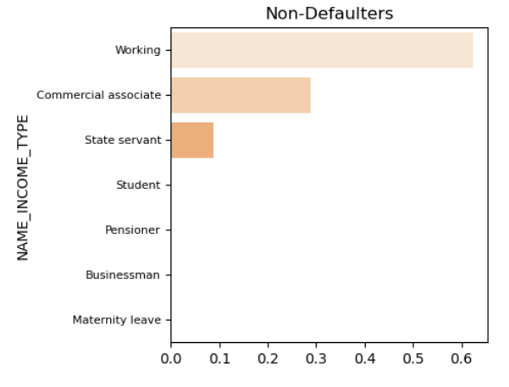
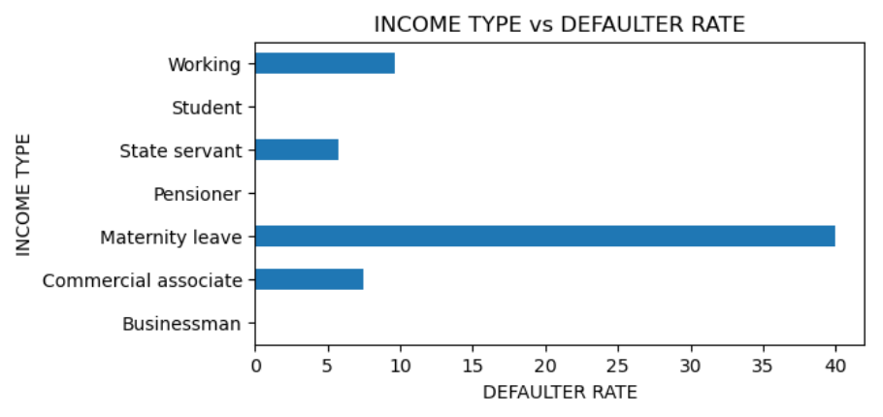
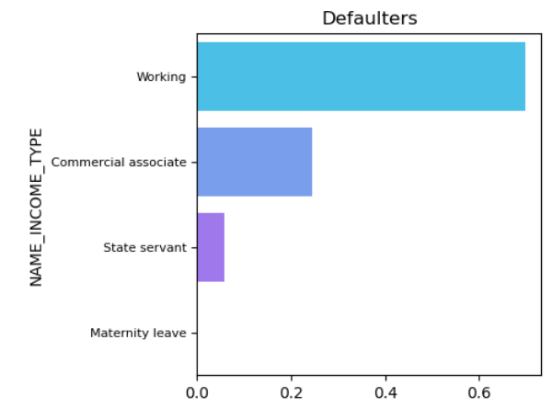
ANALYSIS BASED ON THE INCOME TYPE OF THE CLIENT
The segmented univariate analysis graph on the left side shows working professionals as the top loan applicants, while students, pensioners, and businessmen are the least likely to apply. This is likely because students and pensioners may not need large loans or may not be able to afford repayment, and businessmen may have other funding sources available.
The bivariate analysis graph above shows that, Businessman, Students and Pensioner has the lowest defaulter rate provided, they also have the lowest application rate whereas females with maternity leave have the highest defaulter rate. Though the highest number of loan application has come from Working category, the defaulter rate is highest for MAT cases

Slide 8
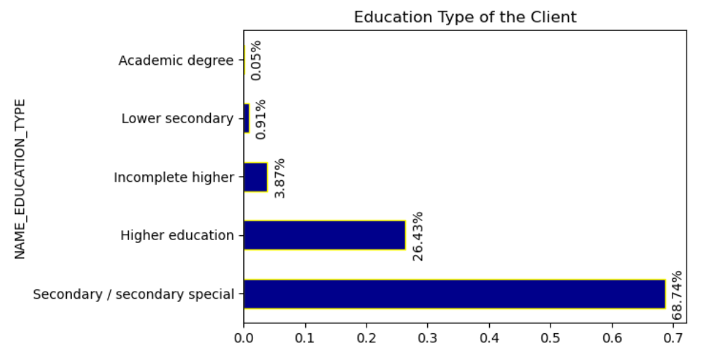
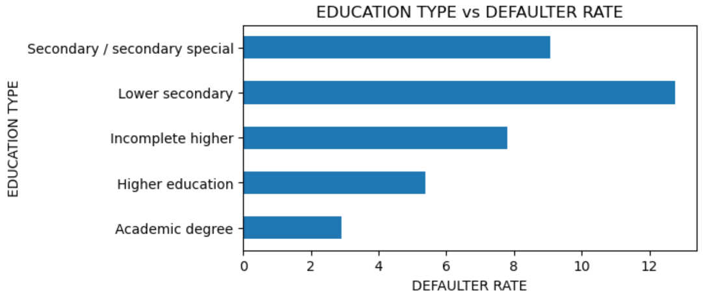
ANALYSIS BASED ON THE EDUCATION LEVEL OF THE CLIENT
BVARIATE ANALYSIS
UNIVARIATE ANALYSIS
People with secondary education has the highest application rate and academic degree has the lowest application rate
While the highest loan application rate is for Secondary education, the default rate peaks for Lower Secondary. This suggests lower education levels may correlate with higher default rates, potentially due to lower income and financial constraints.
However, this assumption requires validation through analysis of income levels and loan credit amounts associated with different education types.

Slide 9
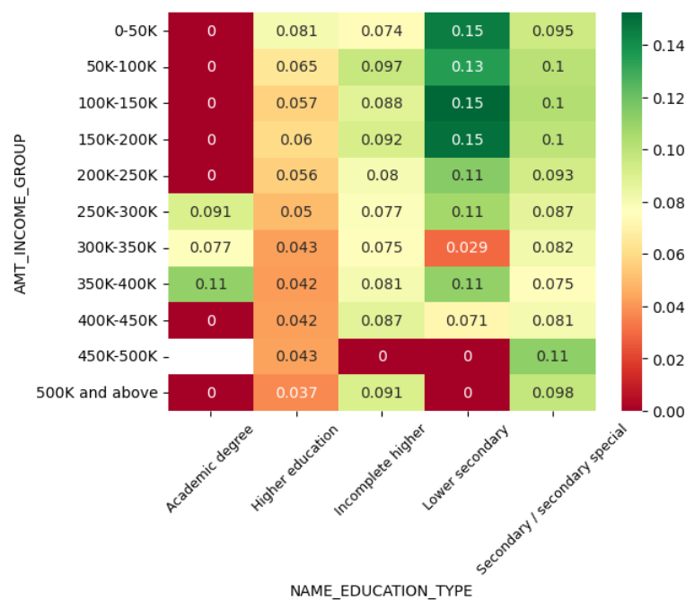
PLOTTING OF CORRELATION MATRIX BETWEEN EDUCATION TYPE, INCOME LEVEL AND DEFAULTER RATE (TARGET)
Higher income earners are less likely to default on loans across all education levels. The borrowers with higher incomes are better positioned to repay their loans.
Borrowers with an academic degree are generally least likely to default than those with lower education levels. Across most income levels, the heatmaps show a red color for the "Academic degree" row compared to other education types. This suggests that completing a higher level of education leads to better financial outcomes and a lower risk of default.
There is a significant variation in the defaulter rates within education levels. Even among borrowers with an academic degree, the heatmaps show a range of default rates across different income levels. This suggests that factors other than education level also play a role in loan repayment.

Slide 10
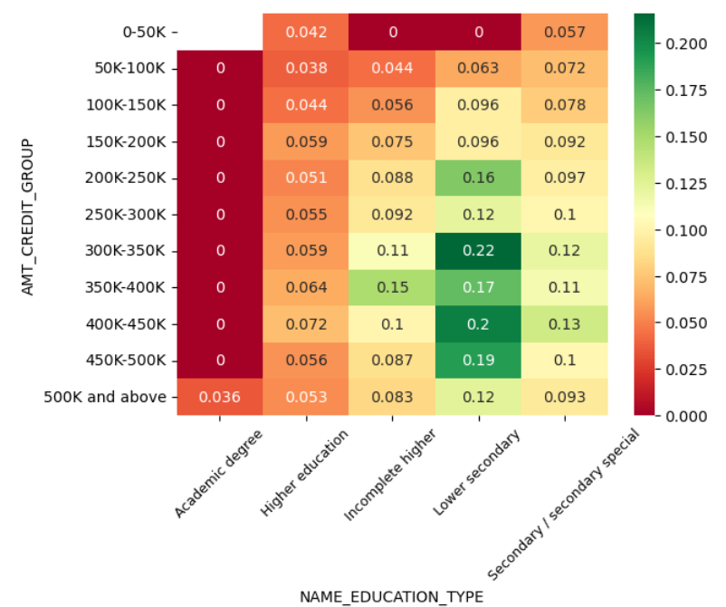
PLOTTING OF CORRELATION MATRIIX BETWEEN EDUCATION TYPE, LOAN CREDIT AMOUNT AND DEFAULTER RATE (TARGET)
Borrowers with an academic degree have lowest default rates across most of the loan credit amounts.
There's a slight trend of lower default rates for smaller loan amounts, but the effect is weak and not consistent for all education levels.
While the education level and loan amount may be related to loan default rates with a weak negative correlation, it does not necessarily mean that one causes the other. There could be other factors influencing default rates that are not captured here
Even people with higher education have the lowest default rate across all the loan credit amount which shows that education level is definitely a driving factor for determining the defaulters

Slide 11
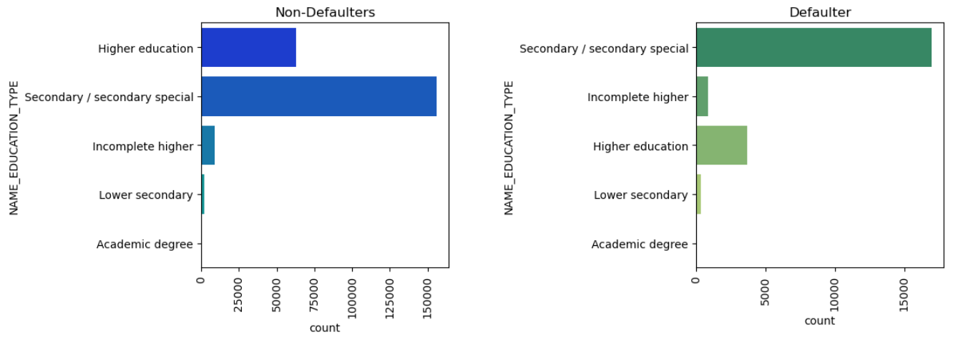
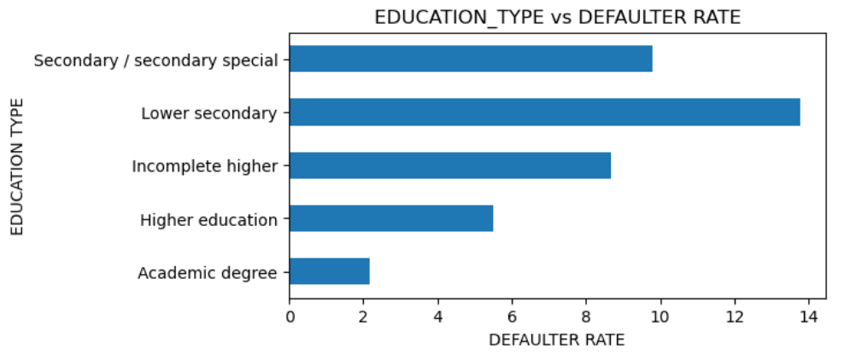
SEGMENTED UNIVARIATE AND BIVARIATE ANALYSIS OF EDUCATION LEVEL OF THE CLIENT
The company can focus on providing loan to higher education & academic degree more as clients with these education levels have defaulted the least

Slide 12
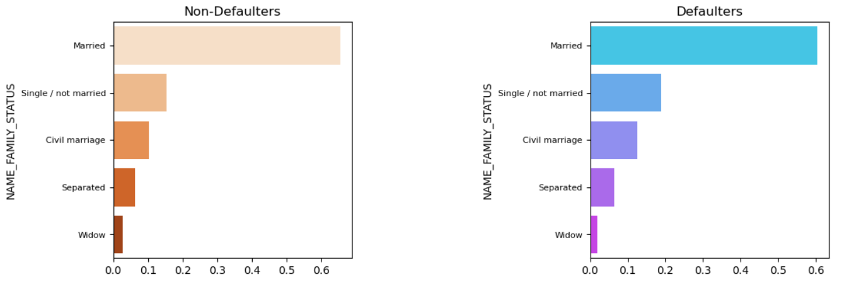
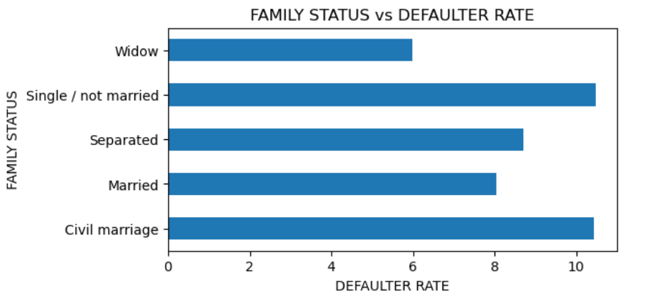
ANALYSIS BASED ON THE FAMILY STATUS OF THE CLIENT
Though the Widows have the lowest application rate, which could be due to changing financial priorities or income reductions after demise of a spouse, they also have the lowest defaulter rate.
However, other single people have the highest defaulter rate which requires further investigation while lending loan

Slide 13
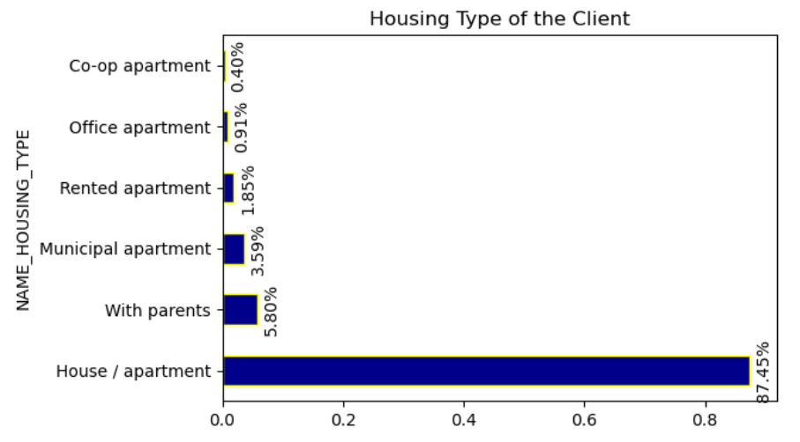
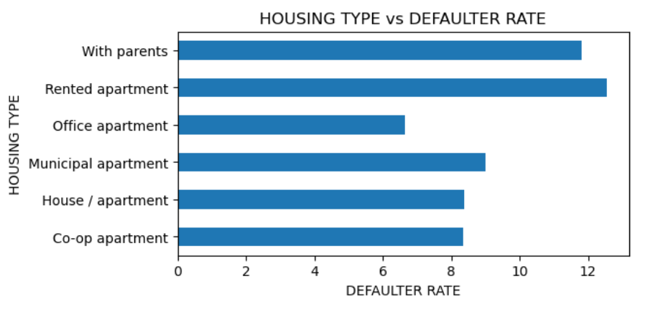
ANALYSIS BASED ON THE HOUSING TYPE OF THE CLIENT
UNIVARIATE ANALYSIS
BVARIATE ANALYSIS
As per the first graph shown above, People who own their own place (house/apartment) might have a higher loan application rate for larger needs like home improvement or investment loans, while Co-Op and office apartment residents might have stricter limitations on renovations or ownership rights, reducing their loan application needs.
As per the second graph, clients living in rented apartments have the highest loan default rate. This could be due to factors like lower income, less stable housing situations or rental obligations.
Clients with employer-provided housing have the lowest default rate. This might be because they do not have rental obligations which is a savings which could help in the repayment of loan installments.
Those living with parents also have a higher default rate, possibly due to a lack of financial independence.

Slide 14
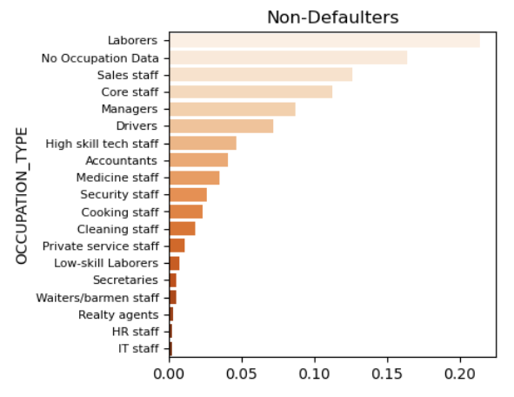
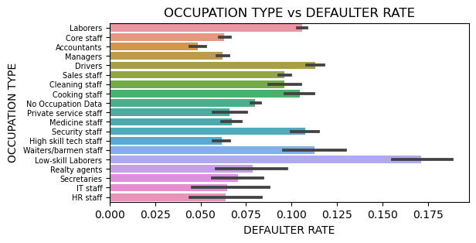
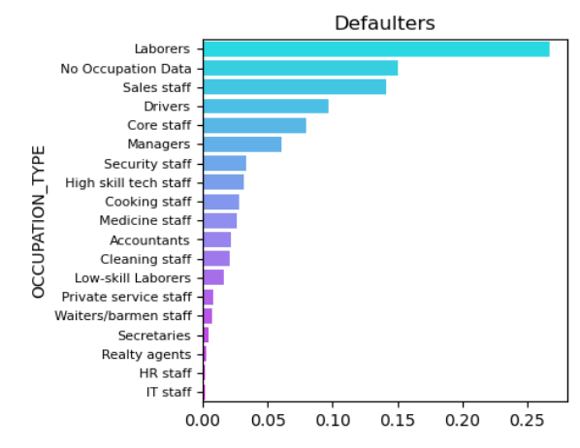
ANALYSIS BASED ON THE OCCUPATION TYPE OF THE CLIENT
Based on segmented univariate analysis, low skilled laborers exhibit a lower loan application rate but the highest default rate. Further examination of the correlation between income level and occupation type is necessary to determine if it is a significant factor in identifying defaulters.

Slide 15
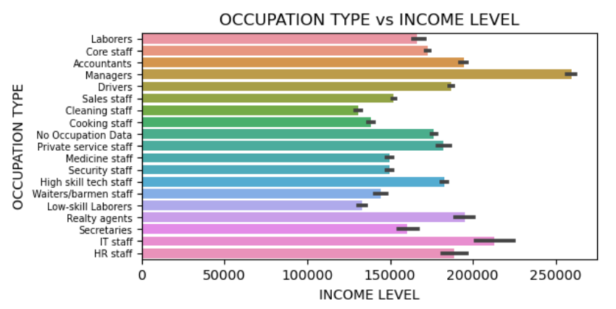
BIVARIATE ANALYSIS OF INCOME LEVELS VS OCCUPATION TYPE TO CHECK ON THE INCOME DISTRUNUTION ACROSS VARIOUS OCCUPATION
The graph indicates that managers have the highest income level, with accountants, IT, and HR staff also earning relatively high salaries.
Conversely, low skilled laborers and cleaning staff have the lowest salary range.
Additionally, accountants and managers exhibit the lowest default rates, while low skilled laborers have the highest default rates, suggesting that occupation type is a significant determinant of loan defaulters.

Slide 16
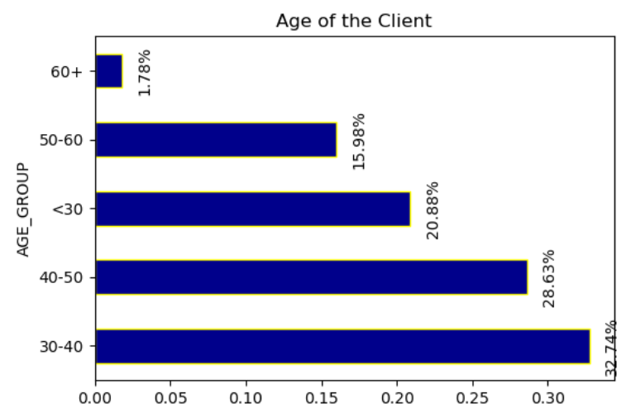
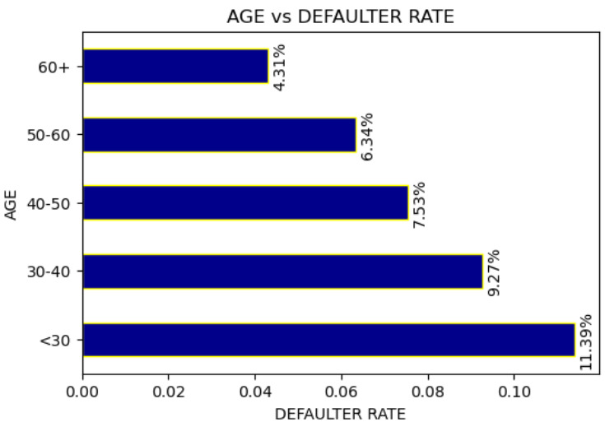
ANALYSIS BASED ON THE AGE OF THE CLIENT
UNIVARIATE ANALYSIS
BVARIATE ANALYSIS
Clients aged between 30 - 50 years show the highest loan application rate, possibly due to increased financial commitments like marriage, children, and homeownership.
Conversely, clients aged 60 years and above exhibit the lowest loan application rate, likely due to fewer financial obligations or reliance on retirement income.
The defaulter rate is also highest for clients below 30 years of age, potentially because younger individuals may face financial challenges or have less established credit histories.

Slide 17
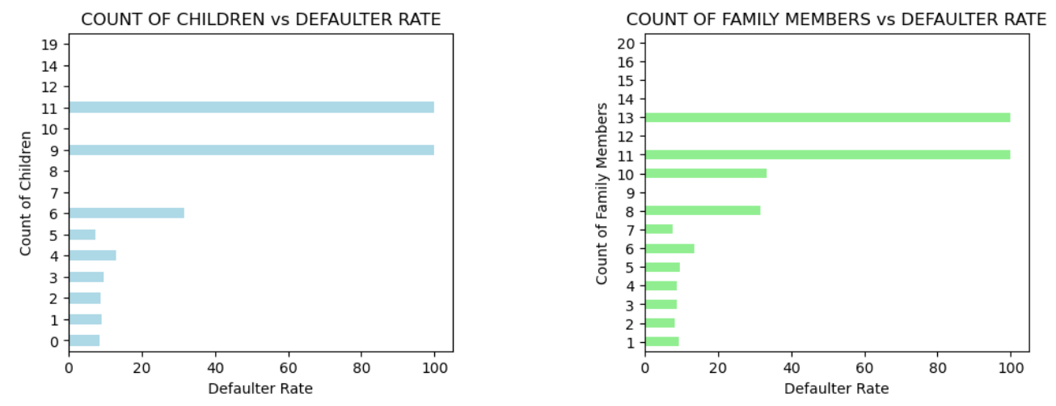
ANALYSIS BASED ON THE NO. OF THE CHILDREN & FAMILY MEMBERS OF THE CLIENT
There is a positive correlation between the count of children and the count of family members.
Individuals with more than 6 children and more than 8 family members have a higher likelihood of defaulting on their payments.

Slide 18
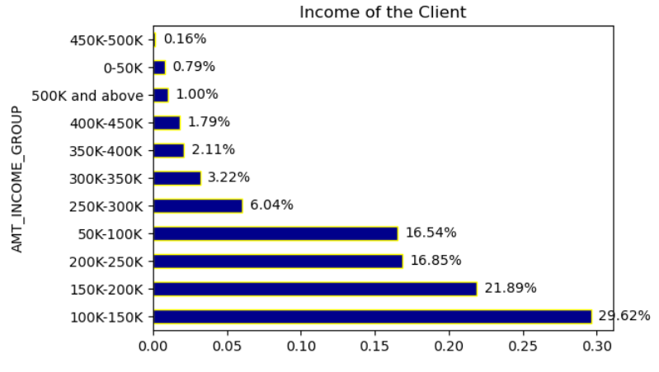
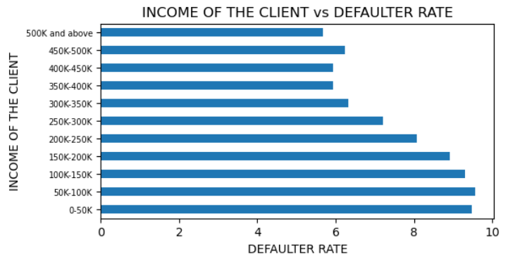
ANALYSIS BETWEEN INCOME LEVEL OF THE CLIENT
UNIVARIATE ANALYSIS
BVARIATE ANALYSIS
The clients who are in the lower income group have the highest defaulter rate.
Therefore, higher the salary, lesser is the chance of getting defaulter.

Slide 19
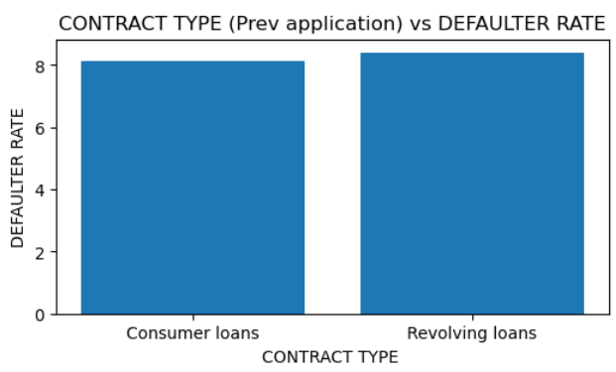
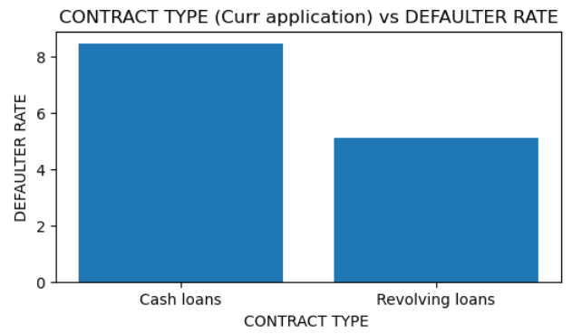
ANALYSIS BASED ON THE CONTRACT TYPE OF THE CLIENT
Previous Application
Current Application
In the previous application, there were no cash loans, and the defaulter rate was higher for Revolving Loans.
However, in the current application, there's no consumer loans provided, and cash loans has been introduced which has the higher defaulter rate now.

Slide 20
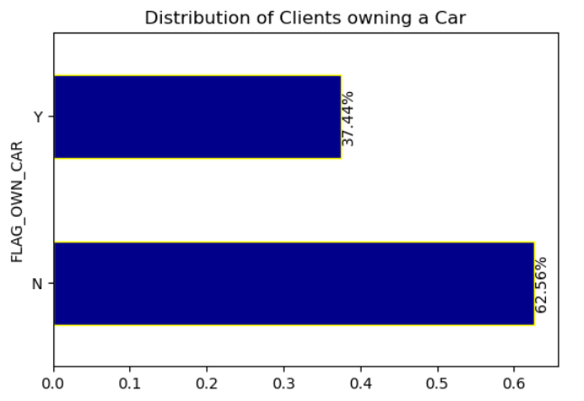
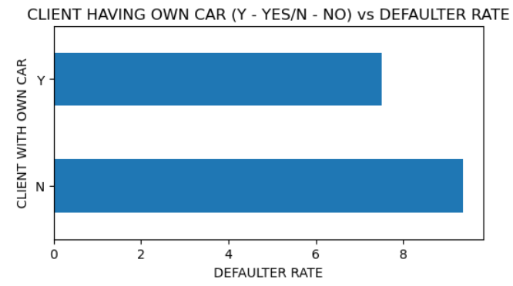
ANALYSIS BASED ON THE OWNERSHIP OF THE CAR
UNIVARIATE ANALYSIS
BVARIATE ANALYSIS
The highest number of application has come from the clients who do not have their own car. By this data we can assume that the purchasing power of the client who are having a car is more than those who do not have the car.
The highest defaulter rate is also for the clients who do not have their own car could be due to financial constraints leading to difficulty in meeting loan obligations or potential instability in income sources

Slide 21
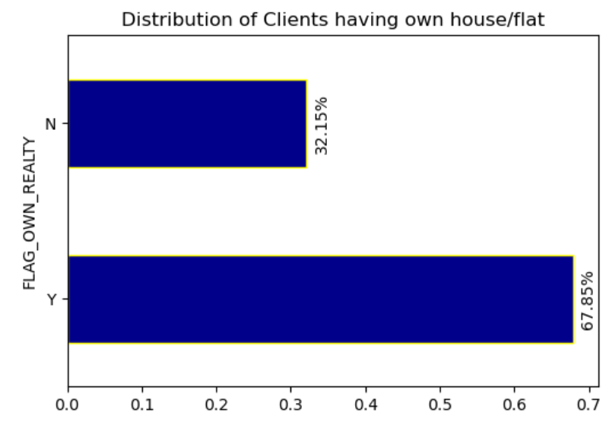
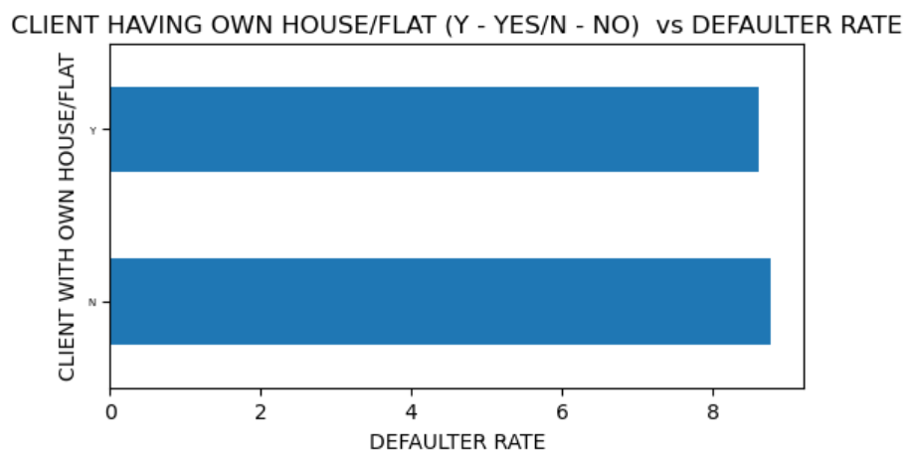
ANALYSIS BASED ON THE OWNERSHIP OF THE HOUSE/FLAT
UNIVARIATE ANALYSIS
BVARIATE ANALYSIS
The loan application rate is lowest for the clients who do not own a house/flat but the defaulter rate is slightly highest for them which can be a driving factor to be considered while providing loan

Slide 22
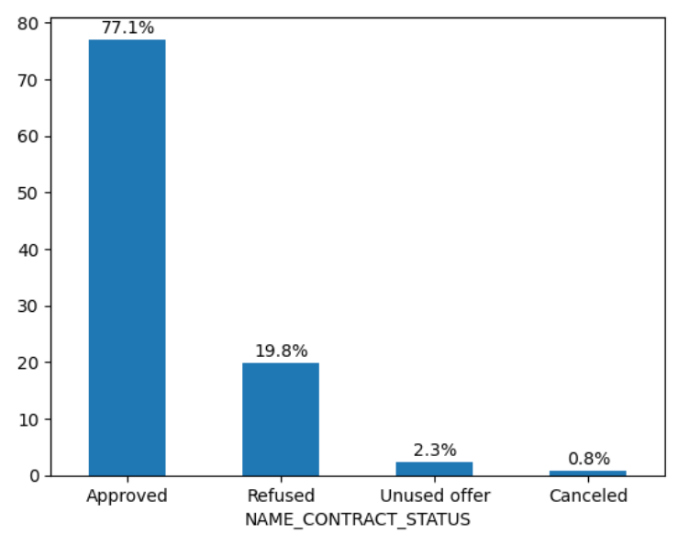
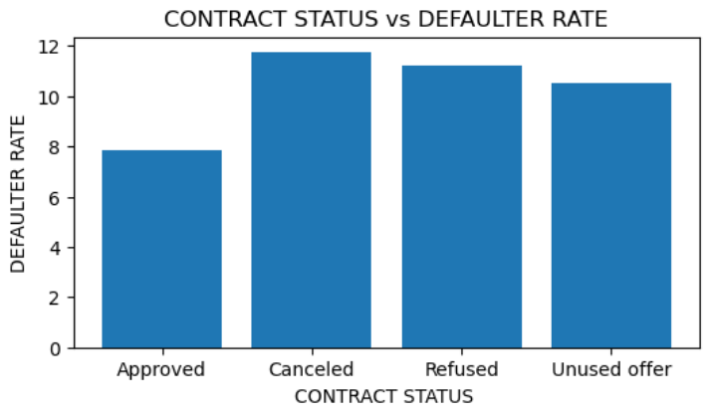
ANALYSIS BASED ON THE CONTRACT STATUS OF THE PREVIOUS LOAN APPLICATION
UNIVARIATE ANALYSIS
BVARIATE ANALYSIS
Around 77% customer's loan has been approved, and rest 23% have been either refused, cancelled or client did not use the offer
The clients whose loan were cancelled/refused during the previous application, have the higher rate of defaulter in the current application. And, clients which loans were approved in the previous application, has the least defaulter rate in the current application.

Slide 23
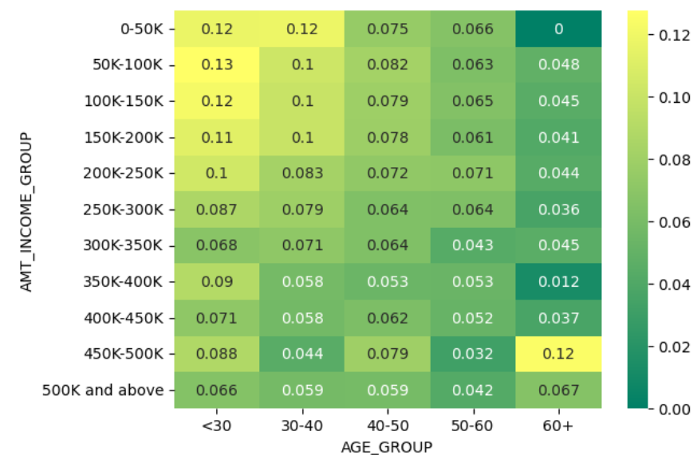
CORRELATION MATRIX BETWEEN AGE, INCOME LEVEL & DEFAULTER RATE
Clients aged less than 30 years exhibit the highest defaulter rate across various income ranges. This trend may be attributed to factors such as limited financial stability, lower experience in managing finances, or higher propensity for risk-taking among younger individuals.
Conversely, clients aged 60 years and above have the lowest defaulter rate across various income ranges. This could be linked to factors such as financial stability acquired over time, lower debt obligations, or conservative financial behavior typically associated with older age groups.

Slide 24
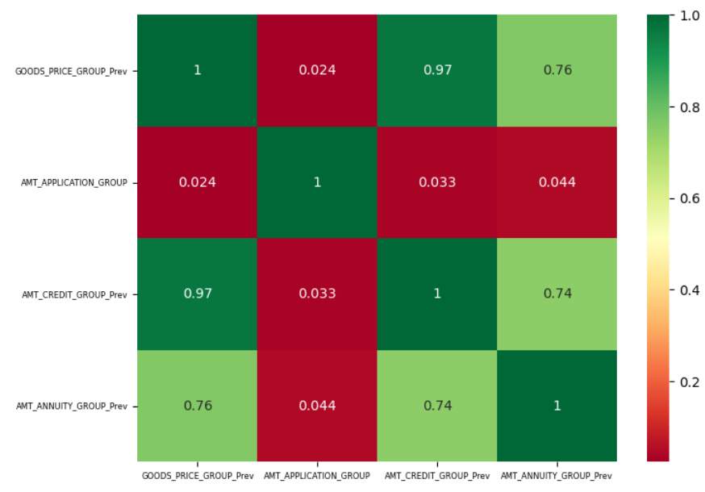
CORRELATION BETWEEN PRICE OF THE GOODS, APPLICATION AMOUNT, AMOUNT CREDITED, AND ANNUNITY AMOUNT ON THE PREVIOUS APPLICATION
Price of the goods for which the loan is applied shows a strong correlation with the credit amount of the loan and also exhibits a stronger correlation with the annuity amount. Higher credit amounts typically result in higher annuity payments, indicating a strong relationship between these variables.
Therefore, the price of the goods, loan credit amount, and annuity amount demonstrate a significant correlation.
However, the loan application amount does not show any correlation with the other factors mentioned, indicating its independence from them.

Slide 25
CONCLUSION
Gender plays a significant role in loan defaulting, with males having a higher tendency to default compared to females.
Women in MAT cases are more likely to default, whereas working professionals and commercial associates have lower default rates, making them preferable for loans.
Clients with lower secondary education are prone to default more than those with higher education degree, & academic degree suggesting a focus on educated individuals for loan provision.
Single or civilly married clients are at higher default risk, urging attention towards married or widowed individuals who exhibit lower default rates.
Clients residing in rental or parental accommodations have higher default rates, emphasizing the importance of targeting homeowners or those in office or cooperative accommodations.
Low-skilled laborers, due to their lower income levels, pose higher default risks, warranting cautious lending practices towards them.
Professions like accountants, managers, and high skilled technologists show lower default rates, indicating them as favorable candidates for loan provision due to their higher income levels.
Clients aged below 30 are prone to higher default rates, while those above 60 exhibit lower default rates; however, the latter group applies for loans less frequently, prompting focus on clients aged between 30 to 50 for lending.

Slide 26
CONCLUSION (continued…)
Higher the count of children & family members, higher is the defaulter rate
Income levels significantly affect default rates, with higher income correlating to lower default chances.
Cash loan recipients tend to default more frequently.
The contract status of previous applications is a key determinant in assessing default risk for repeat applicants, with those previously experiencing loan cancellation or refusal showing a higher default rate, necessitating enhanced scrutiny and investigation before loan processing or approval.
Clients without personal cars tend to default more, possibly due to assumptions about their financial stability; hence, car ownership could be considered as a factor in loan assessment.
Higher-priced goods correlate with larger loan amounts and installment payments, indicating a strong relationship between these factors.
Clients without owned houses or flats have lower loan application rates but slightly higher default rates, suggesting careful consideration when providing loans to this demographic.

